Slide 1
Detection and Counting of nano/macro particles found in Stage I Lung cancer patients (Before/After Treatment)
Pres. by Nareg Ohannesian
02-11-2022

Slide 2
Experimental Details for plasma lung cancer stage one plasma
Used samples: A lot.
Plasma volume: 20 µl.
Type of Cancer: unknown.
Concentration: unknown.
Size Distribution: unknown.
Experimental duration: 60 min.
Antibody used: CD9, CD81, and CD63.

Slide 3
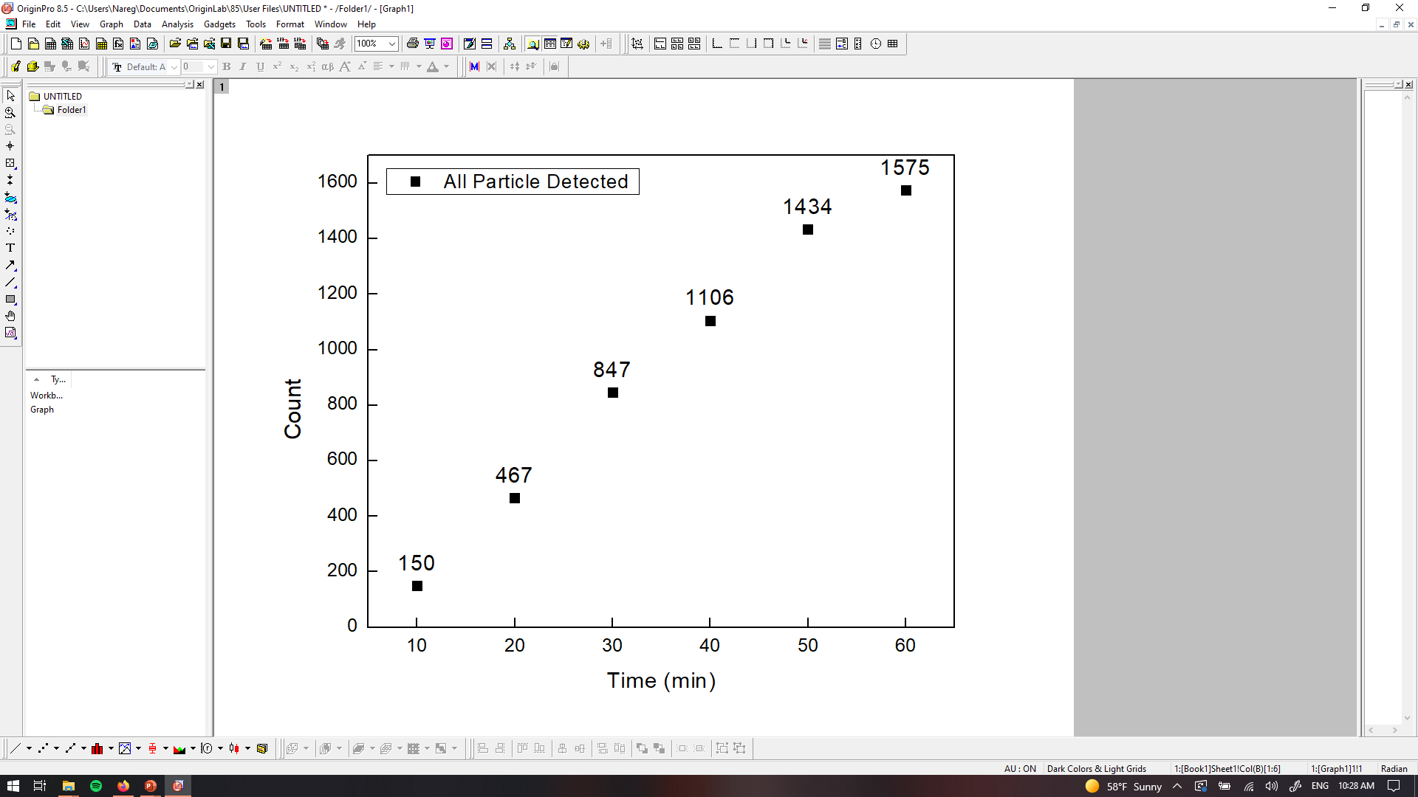
PANORAMA of Plasma Sample 0737-2C (Cancer, reduced count)
Time: 60 min
Count: 1575 (Ex: 1140; Large: 435)
Time: 60 min wash
Count: 419
Note: Before wash count matches the CI of stage 1 (950-1558)
After wash count exceeds the CI for stage 1 (151-370)
Note: 0 % response to miRNA-21
Scale bar: 10 µm

Slide 4
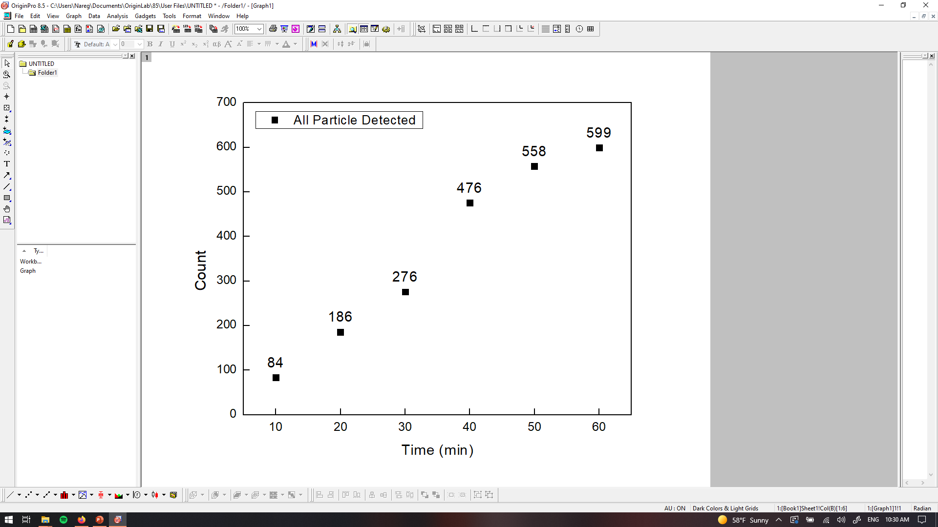
PANORAMA of Plasma Sample 0737-2D (Healthy; Significantly reduced count)
Time: 60 min
Count: 599 (Ex: 380; Large: 219)
Time: 60 min wash
Count: 82
Note: Before wash count lower CI of stage 1 (950-1558); higher than healthy (64-172)
After wash count lower the CI for stage 1 (151-370); higher than healthy (9-27)
Note: 0 % response to miRNA-21
Scale bar: 10 µm

Slide 5

PANORAMA of Plasma Sample 0737-7C (looks cancer)
Time: 60 min
Count: 885 (Ex: 447 Large: 438)
Time: 60 min wash
Count: 162
Note: Before wash count slightly lower CI of stage 1 (950-1558);
After wash count matches low end CI for stage 1 (151-370);
Note: 0 % response to miRNA-21
Scale bar: 10 µm

Slide 6

PANORAMA of Plasma Sample 0737-8B (looks cancer)
Time: 60 min
Count: 905 (Ex: 707 Large: 198)
Time: 60 min wash
Count: 238
Note: Before wash count matches low end CI of stage 1 (950-1558);
After wash count slightly lower the CI for stage 1 (151-370);
Note: 0 % response to miRNA-21
Scale bar: 10 µm

Slide 7
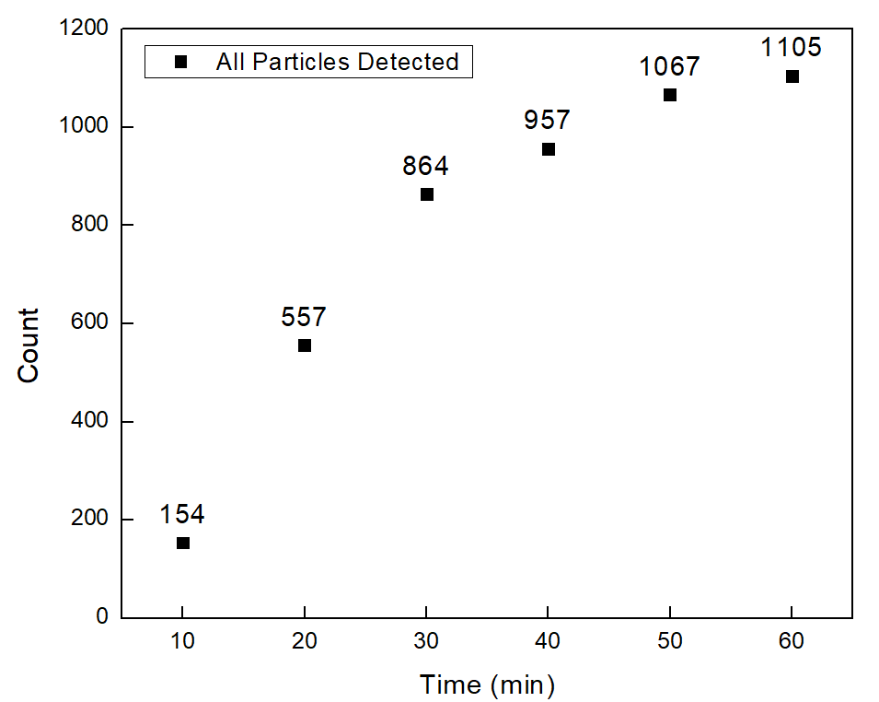
PANORAMA of Plasma Sample 0737-8C (reduced Count)
Time: 60 min
Count: 1105 (Ex: 655 Large: 450)
Time: 60 min wash
Count: 133
Note: Before wash count matches low end CI of stage 1 (950-1558);
After wash count slightly lower the CI for stage 1 (151-370);
Note: 0 % response to miRNA-21
Scale bar: 10 µm

Slide 8
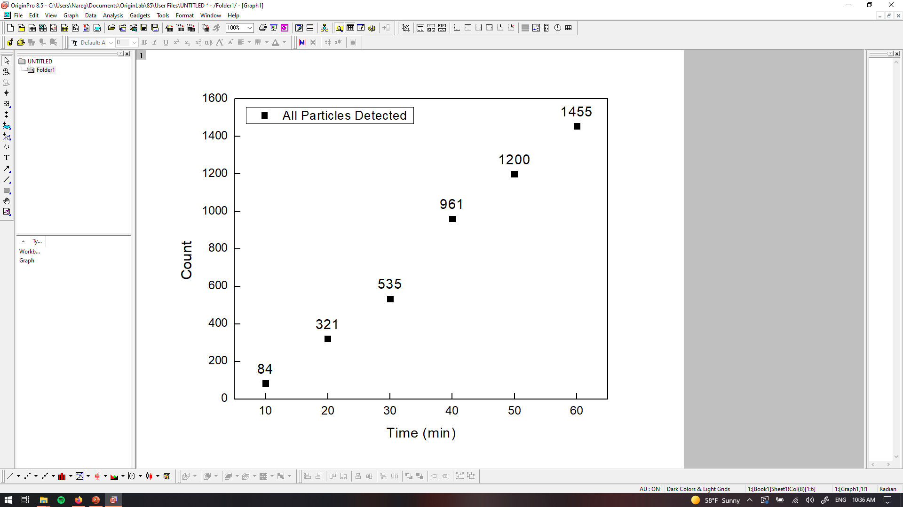

PANORAMA of Plasma Sample 0737-9B (looks cancer)
Time: 60 min
Count: 1455 (Ex: 883 Large: 572)
Time: 60 min wash
Count: 233
Note: Before wash count matches CI of stage 1 (950-1558);
After wash count matches CI for stage 1 (151-370);
Note: 0 % response to miRNA-21
Scale bar: 10 µm

Slide 9
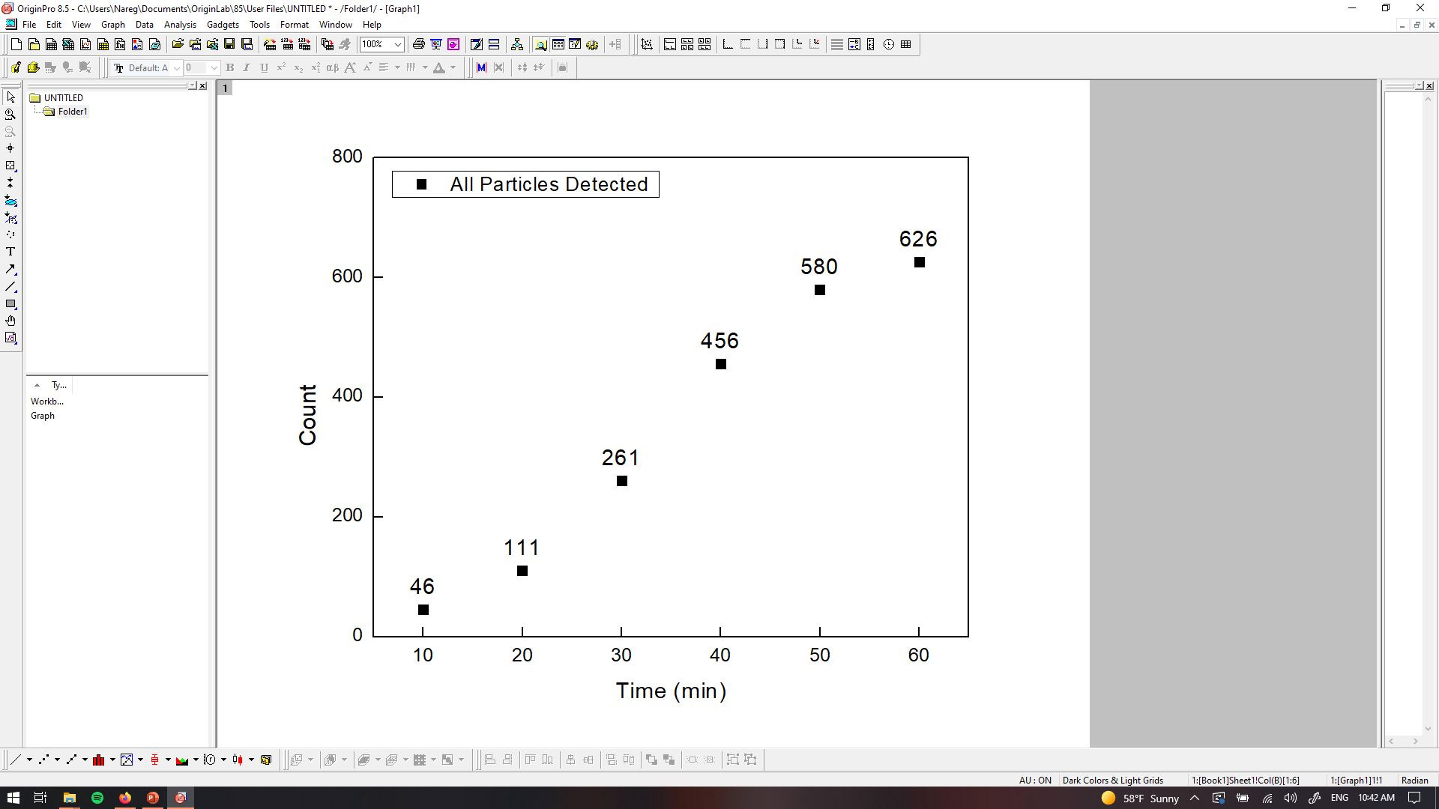

PANORAMA of Plasma Sample 0737-9C (significantly reduced count)
Time: 60 min
Count: 626 (Ex: 310 Large: 316)
Time: 60 min wash
Count: 109
Note: Before wash count matches low end CI of stage 1 (950-1558);
After wash count slightly lower the CI for stage 1 (151-370);
Note: 0 % response to miRNA-21
Scale bar: 10 µm

Slide 10
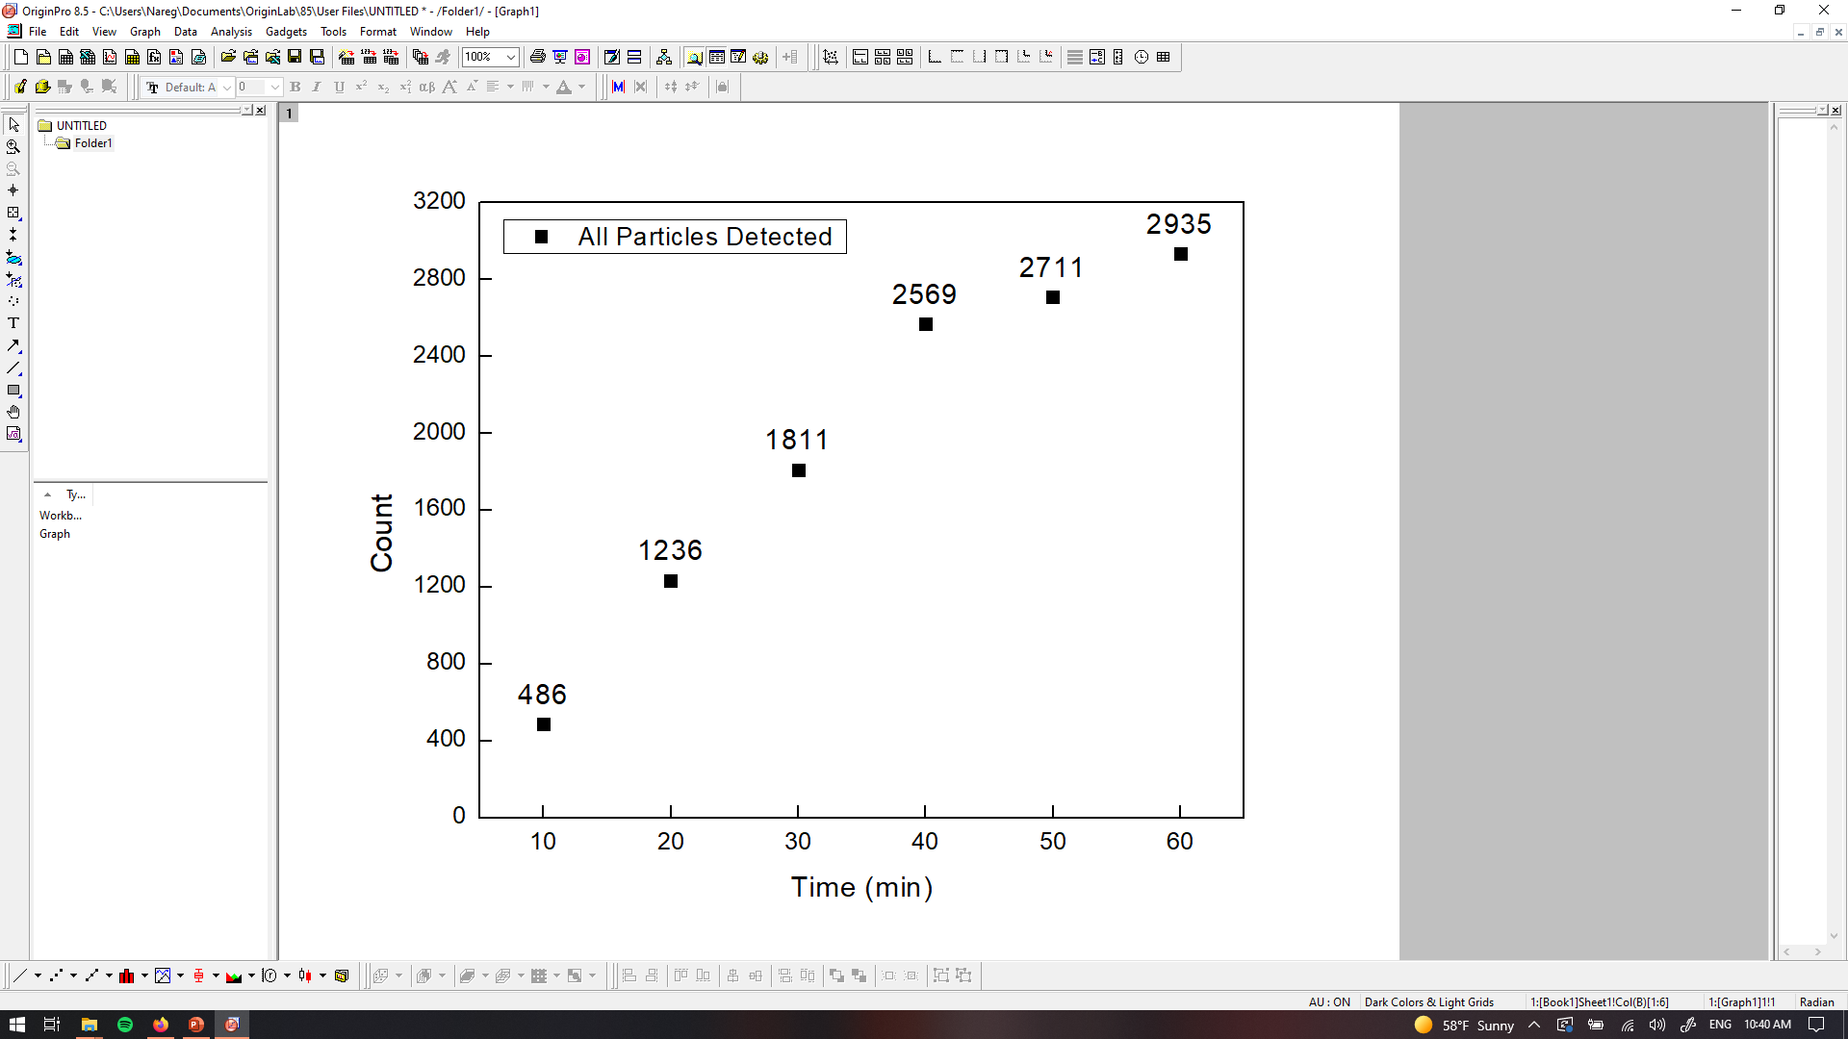
PANORAMA of Plasma Sample 0737-11B (looks cancerous)
Time: 60 min
Count: 2935 (Ex: 1807 Large: 1128)
Time: 60 min wash
Count: 606
Note: Before wash count exceeds CI of stage 1 (950-1558);
After wash count exceeds CI for stage 1 (151-370);
Note: 0 % response to miRNA-21
Scale bar: 10 µm

Slide 11

PANORAMA of Plasma Sample 0737-11C (reduced count)
Time: 60 min
Count: 987 (Ex: 807 Large: 180)
Time: 60 min wash
Count: 170
Note: Before wash count matches lower end CI of stage 1 (950-1558);
After wash count matches lower end CI for stage 1 (151-370);
Note: 0 % response to miRNA-21
Scale bar: 10 µm

Slide 12

PANORAMA of Plasma Sample 0737-11D (Reduced Count)
Time: 60 min
Count: 1063 (Ex: 847 Large: 216)
Time: 60 min wash
Count: 133
Note: Before wash count matches lower end CI of stage 1 (950-1558);
After wash count lower CI for stage 1 (151-370);
Note: 0 % response to miRNA-21
Scale bar: 10 µm

Slide 13
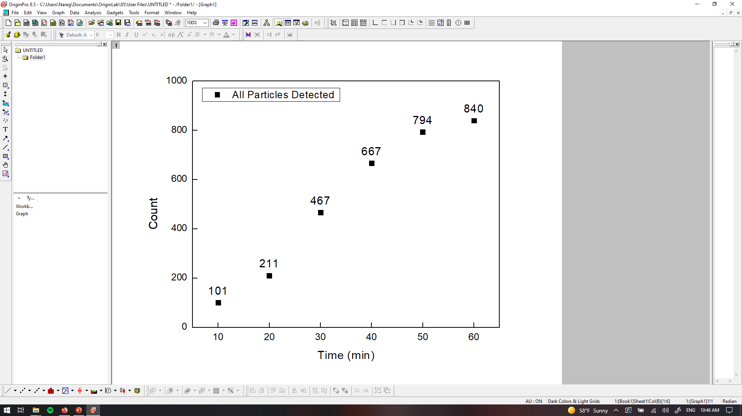
PANORAMA of Plasma Sample 0737-13B ( Looks cancer; slightly increased Count)
Time: 60 min
Count: 840 (Ex: 733 Large: 107)
Time: 60 min wash
Count: 151
Note: Before wash count matches lower end CI of stage 1 (950-1558);
After wash count matches lower end CI for stage 1 (151-370);
Note: 0 % response to miRNA-21
Scale bar: 10 µm

Slide 14
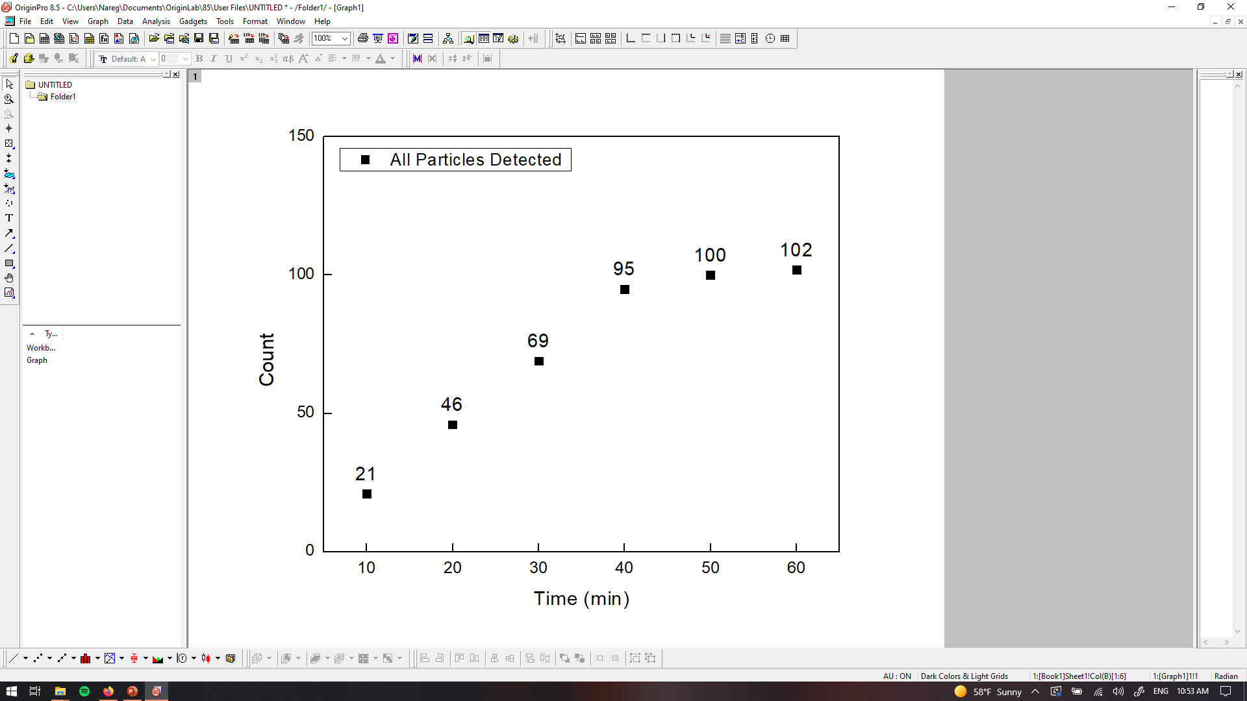
PANORAMA of Plasma Sample 0737-13C (looks healthy)
Time: 60 min
Count: 102 (Ex: 65 Large: 37)
Time: 60 min wash
Count: 48
Note: Before wash count lower CI of stage 1 (950-1558); matches healthy (64-172)
After wash count lower end CI for stage 1 (151-370); matches (9-27)
Note: 0 % response to miRNA-21
Scale bar: 10 µm

Slide 15
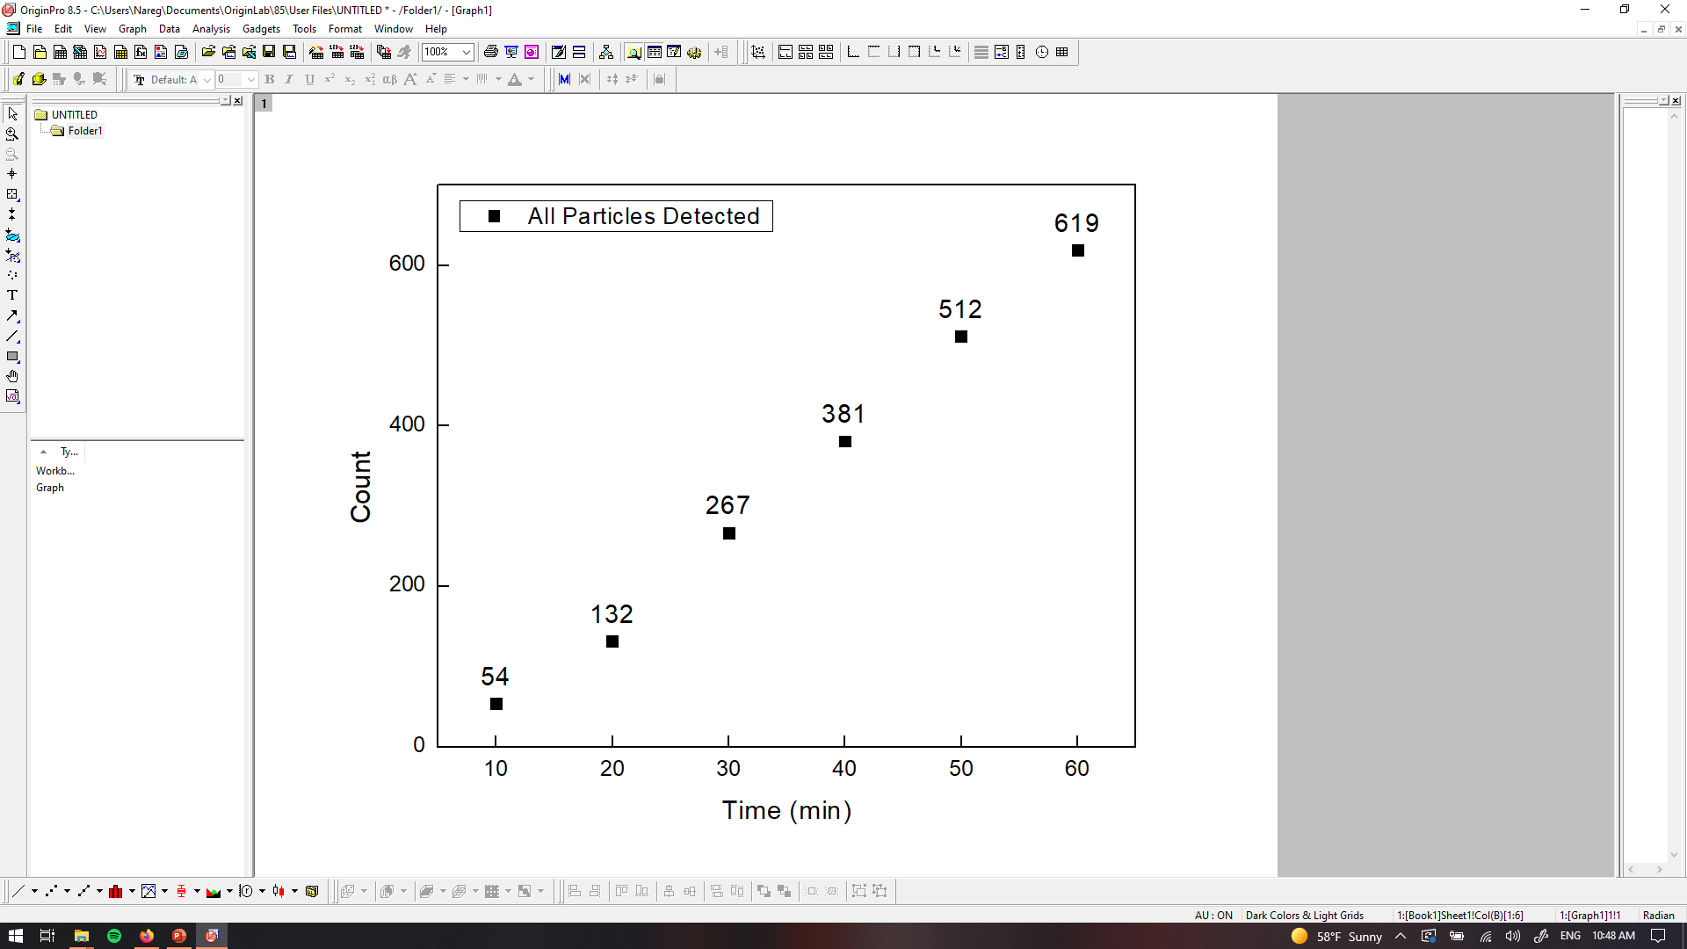
PANORAMA of Plasma Sample 0737-13D (Looks healthy; increased count)
Time: 60 min
Count: 619 (Ex: 405 Large: 219)
Time: 60 min wash
Count: 77
Note: Before wash count lower CI of stage 1 (950-1558)
After wash count between CI for stage 1 (151-370)and healthy (9-27)
Note: 0 % response to miRNA-21
Scale bar: 10 µm

Slide 16


PANORAMA of Plasma Sample 0737-17B (looks cancer, slightly increased count)
Time: 60 min
Count: 1489 (Ex: 1122 Large: 367)
Time: 60 min wash
Count: 115
Note: Before wash count lower CI of stage 1 (950-1558)
After wash count slightly lower CI for stage 1 (151-370)
Note: 0 % response to miRNA-21
Scale bar: 10 µm

Slide 17

PANORAMA of Plasma Sample 0737-17C (reduced Count)
Time: 60 min
Count: 779 (Ex: 578 Large: 201)
Time: 60 min wash
Count: 81
Note: Before wash count slightly lower CI of stage 1 (950-1558)
After wash count lower CI for stage 1 (151-370)
Note: 0 % response to miRNA-21
Scale bar: 10 µm

Slide 18
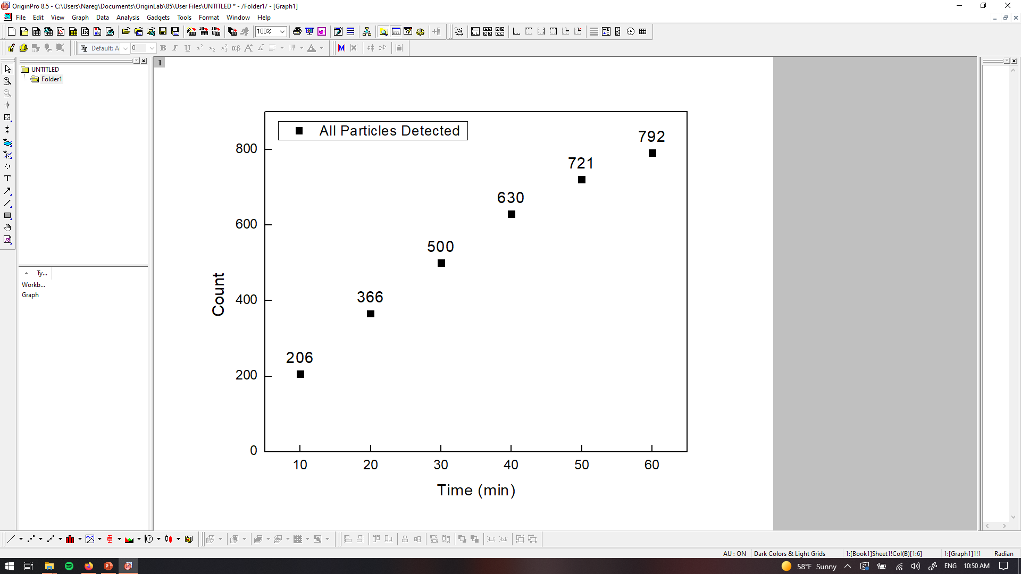
PANORAMA of Plasma Sample 0737-19B (looks cancer; reduced Count)
Time: 60 min
Count: 792 (Ex: 531 Large: 261)
Time: 60 min wash
Count: 221
Note: Before wash count slightly lower CI of stage 1 (950-1558)
After wash count match CI for stage 1 (151-370)
Note: 0 % response to miRNA-21
Scale bar: 10 µm

Slide 19
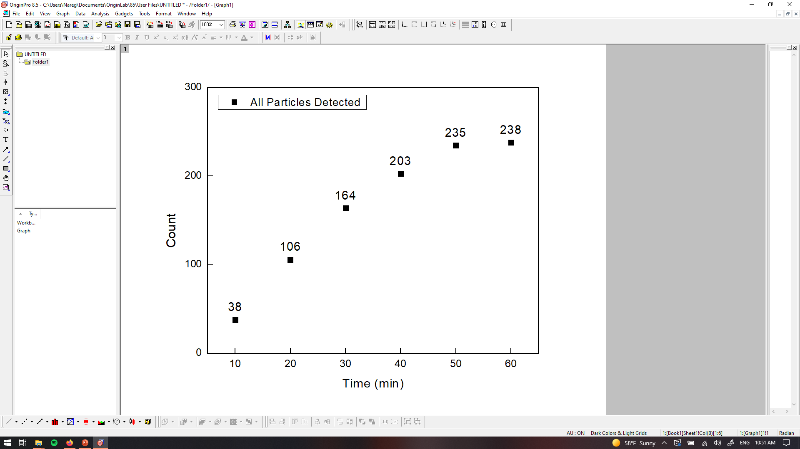
PANORAMA of Plasma Sample 0737-19C (looks Healthy)
Time: 60 min
Count: 238 (Ex: 208 Large: 30)
Time: 60 min wash
Count: 33
Note: Before wash count significantly lower CI of stage 1 (950-1558)
After wash count significantly lower CI for stage 1 (151-370)
Note: 0 % response to miRNA-21
Scale bar: 10 µm

Slide 20
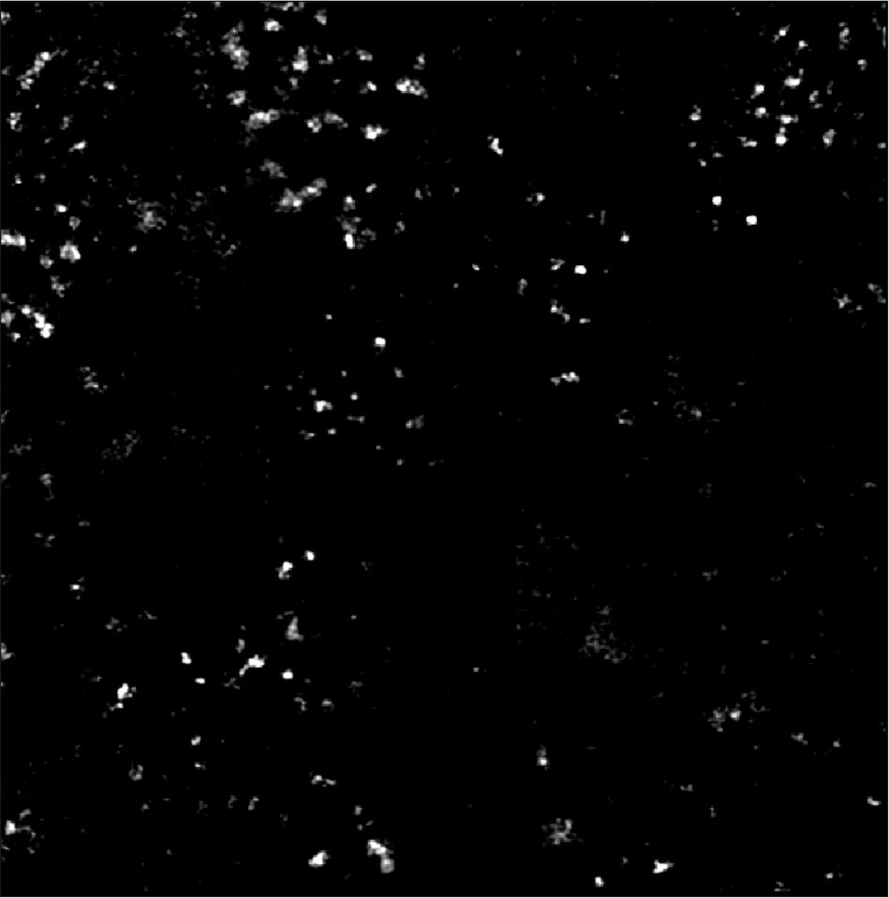
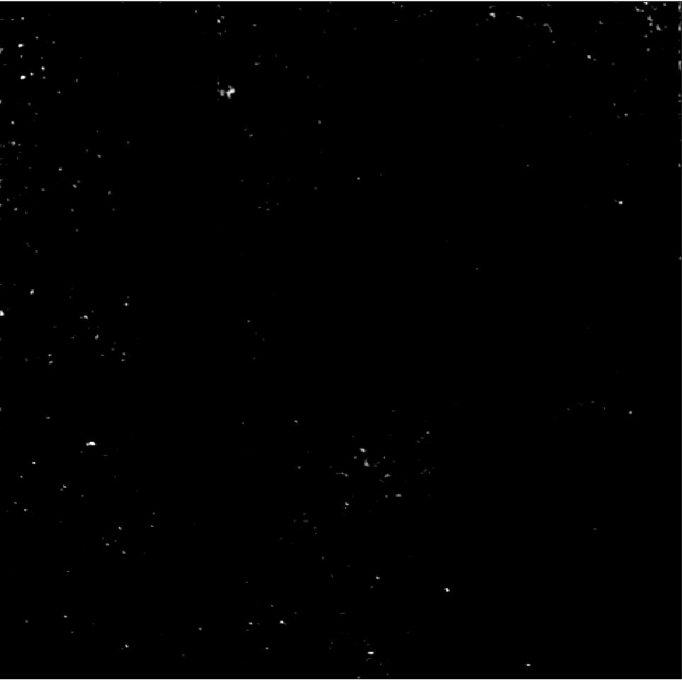
PANORAMA of Plasma Sample 0737-24B (looks cancer)
Before Wash
Number of Particles detected: 643
Number of Exosomes detected: 454
After Wash
Number of Exosomes Retained: 214
Note: 0 % response to miRNA-21
Look cancerous
Scale Bar: 10 µm

Slide 21
PANORAMA of Plasma Sample 0737-24C (Similar to A)
Before Wash
Number of Particles detected: 934
Number of Exosomes detected: 639
After Wash
Number of Exosomes Retained: 110
Scale Bar: 10 µm

Slide 22
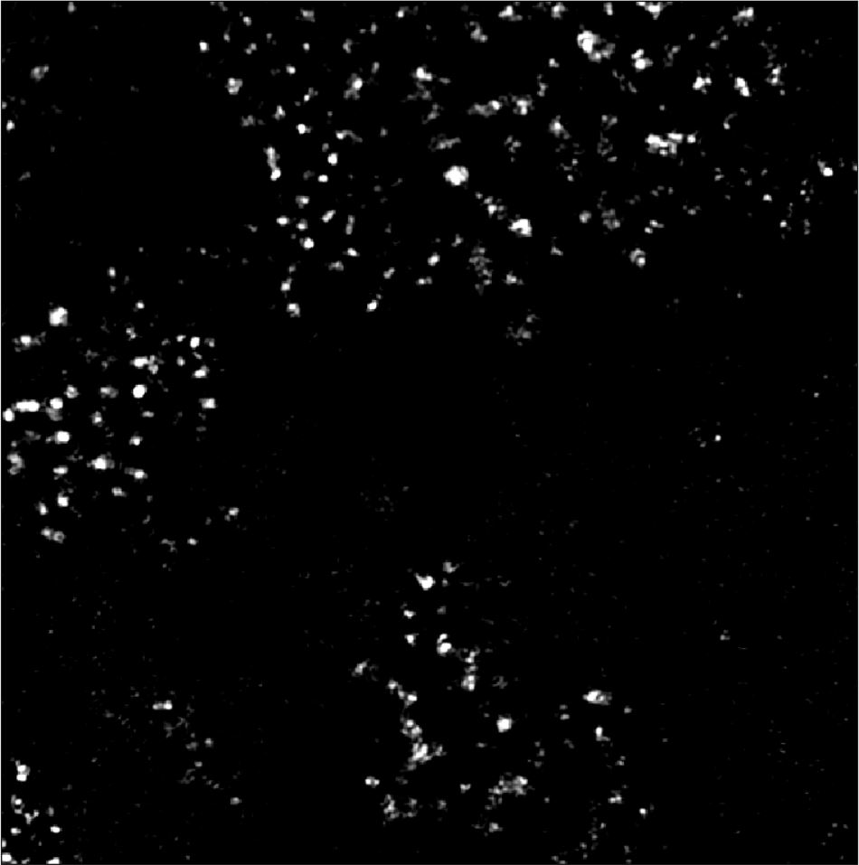

PANORAMA of Plasma Sample 0737-25B (Increased Count)
Before Wash
Number of Particles detected: 782
Number of Exosomes detected: 590
After Wash
Number of Exosomes Retained: 122
Note: 0 % response to miRNA-21
Look cancerous
Scale Bar: 10 µm

Slide 23
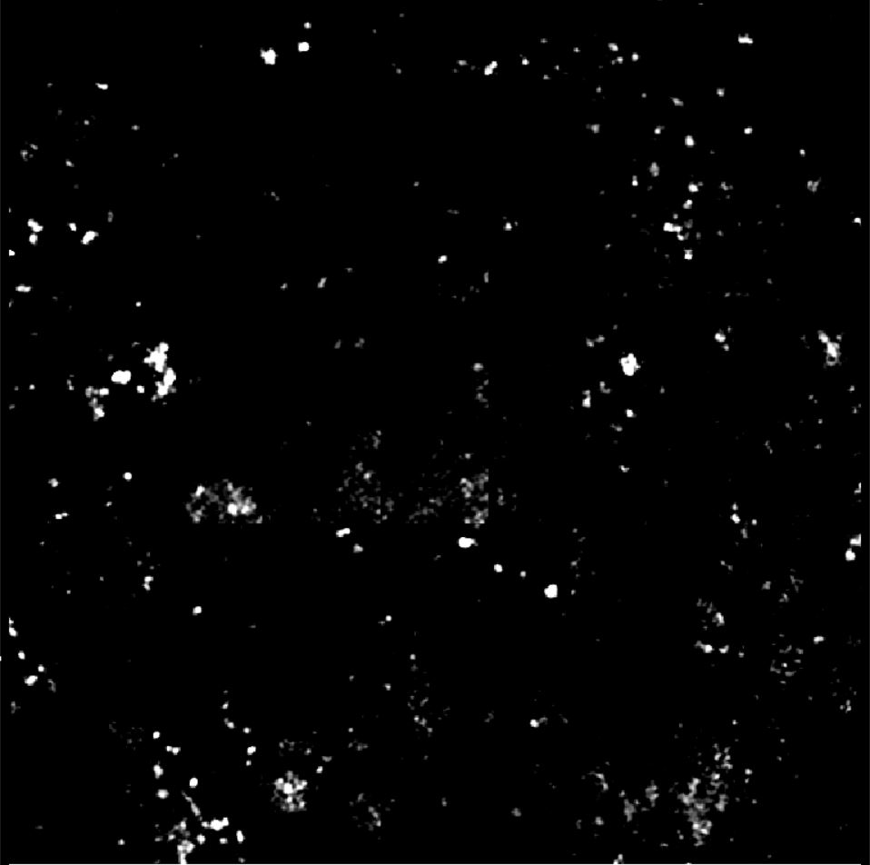
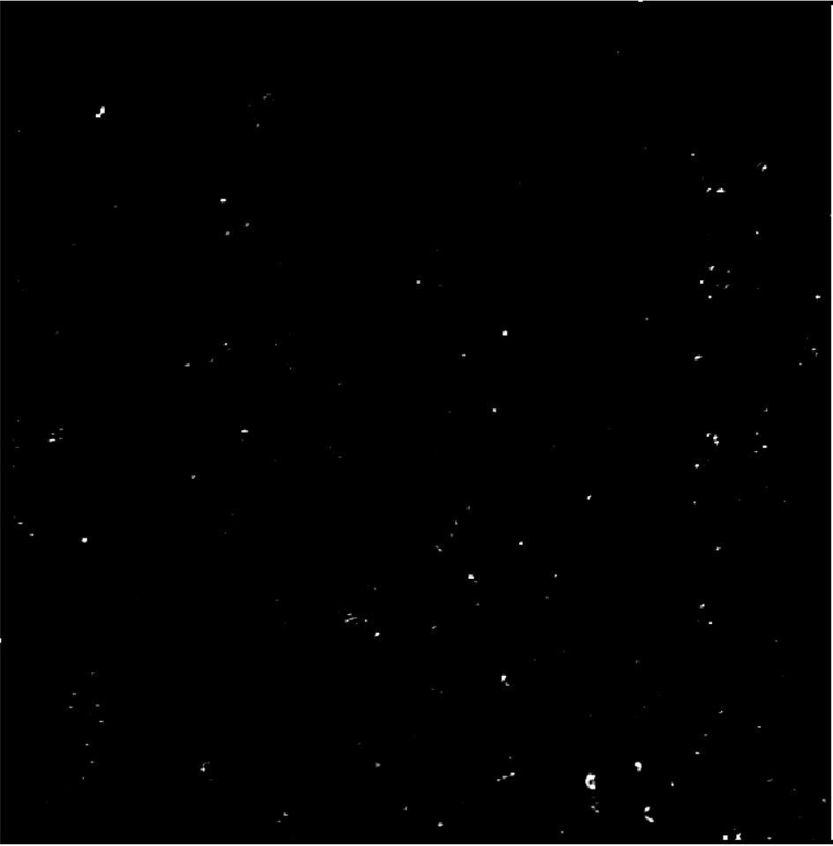
PANORAMA of Plasma Sample 0737-25C (reduced Count)
Before Wash
Number of Particles detected: 328
Number of Exosomes detected: 262
After Wash
Number of Exosomes Retained: 127
Note: 0 % response to miRNA-21
Look cancerous
Scale Bar: 10 µm

Slide 24
Comparison of particle/exosome counts before and after treatment
Patient | All | Large | Exosome all | Retained Exosomes | Prediction Ratio Based | Count based
2 (C/A) | 0.699689 | 2.351351 | 0.551791 | 0.39980916 | Healthy | Cancer
2 (D/A) | 0.266104 | 1.183784 | 0.18393 | 0.078244275 | Healthy | Healthy
7 (C/A) | 0.982242 | 0.73 | 1.48505 | 1.2 | Cancer | Cancer
8 (B/A) | 0.491314 | 0.223224 | 0.740314 | 1.076923077 | Cancer | Cancer
8 (C/A) | 0.599891 | 0.507328 | 0.685864 | 0.601809955 | Healthy | Buffer zone
9 (B/A) | 0.664384 | 0.544762 | 0.774561 | 1.259911894 | Cancer | Cancer
9 (C/A) | 0.285845 | 0.300952 | 0.27193 | 0.240088106 | Healthy | Buffer Zone
11 (B/A) | 2.608889 | 2.436285 | 2.72549 | 1.81981982 | Cancer | Cancer
11 (C/A) | 0.877333 | 0.388769 | 1.217195 | 0.510510511 | Healthy | Cancer
11 (D/A) | 0.944889 | 0.466523 | 1.277526 | 0.399399399 | Healthy | Bufer Zone
13 (B/A) | 1.676647 | 1.287879 | 1.98645 | 1.170542636 | Cancer | Cancer
13 (C/A) | 0.203593 | 0.280303 | 0.176152 | 0.372093023 | Healthy | Healthy
13 (D/A) | 1.235529 | 1.659091 | 1.097561 | 0.596899225 | Healthy | Healthy
17 (B/A) | 1.428983 | 1.115502 | 1.718224 | 1.105769231 | Cancer | Buffer Zone
17 (C/A) | 0.747601 | 0.610942 | 0.885145 | 0.778846154 | Healthy | Healthy
19 (B/A) | 0.771178 | 1.8 | 0.602041 | 0.610497238 | Healthy | Cancer
19 (C/A) | 0.231743 | 0.206897 | 0.235828 | 0.091160221 | Healthy | Healthy
24 (B/A) | 1.224762 | 1.005319 | 1.347181 | 1.963302752 | Cancer | Cancer
24 (C/A) | 1.779048 | 1.569149 | 1.896142 | 1.009174312 | Cancer | Buffer Zone
25 (B/A) | 0.906141 | 0.777328 | 0.957792 | 0.734939759 | Healthy | Buffer
25 (C/A) | 0.38007 | 0.267206 | 0.425325 | 0.765060241 | Healthy | Buffer

